Slide 1




RNASeq Analysis Workshop
Nov. 5-7, 2020 Florida International University
Nov. 12-14, 2020 University of Puerto Rico
Nov. 19-21, 2020 University of Puerto Rico
Instructor
Ravi Kiran Donthu, Ph.D.
Sponsors
Puerto Rico Science, Technology and Research Trust
Department of Biology, University of Puerto Rico
Institute of Environment, NSF CREST Center for Aquatic Chemistry and Environment
National Science Foundation (NSF)
Puerto Rico
Science, Technology
& Research Trust
UPR - Department of Biology
College of Natural Resource
Río Piedras Campus
Notes:
We have set up three different sessions in order to have an instructor/participant ratio that favors interactions. However, others who are not registered for a given session can still join if they wish to review the material. However, regarding posing questions, preference will be given to those registered for a given session.

Slide 2
Introduction to RNASeq analysis
Day 1
[Session 1]

Slide 3
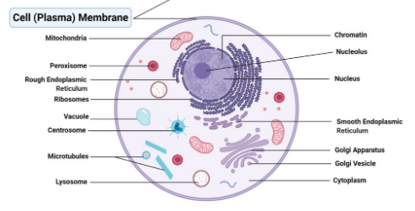
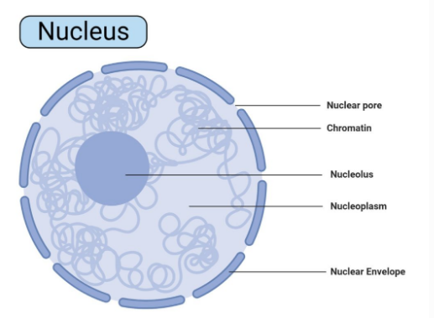
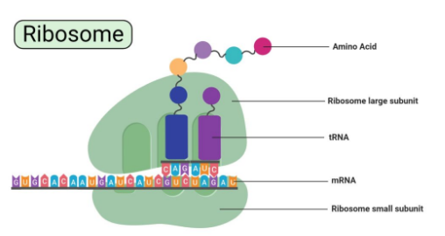
Biological Information moves from DNA to protein
microbenotes.com
Notes:
Jose do you remember that website that had icons and biological diagrams to use with slides?

Slide 4
What questions can we answer using RNASeq analysis?

Slide 5
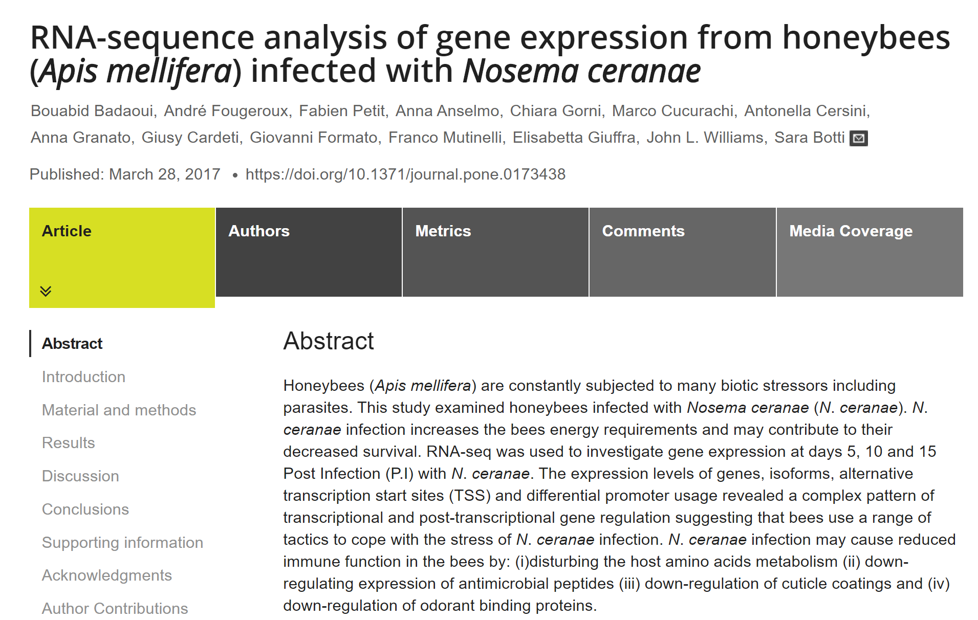
Gene Expression pattern of
Infected vs Uninfected honeybees
Notes:
three bees from each box and at each time point (5, 10 and 15 days post infection, P.I.)
Three time points, 2 conditions, 3 bees per time point and condition = total of 18 bees

Slide 6
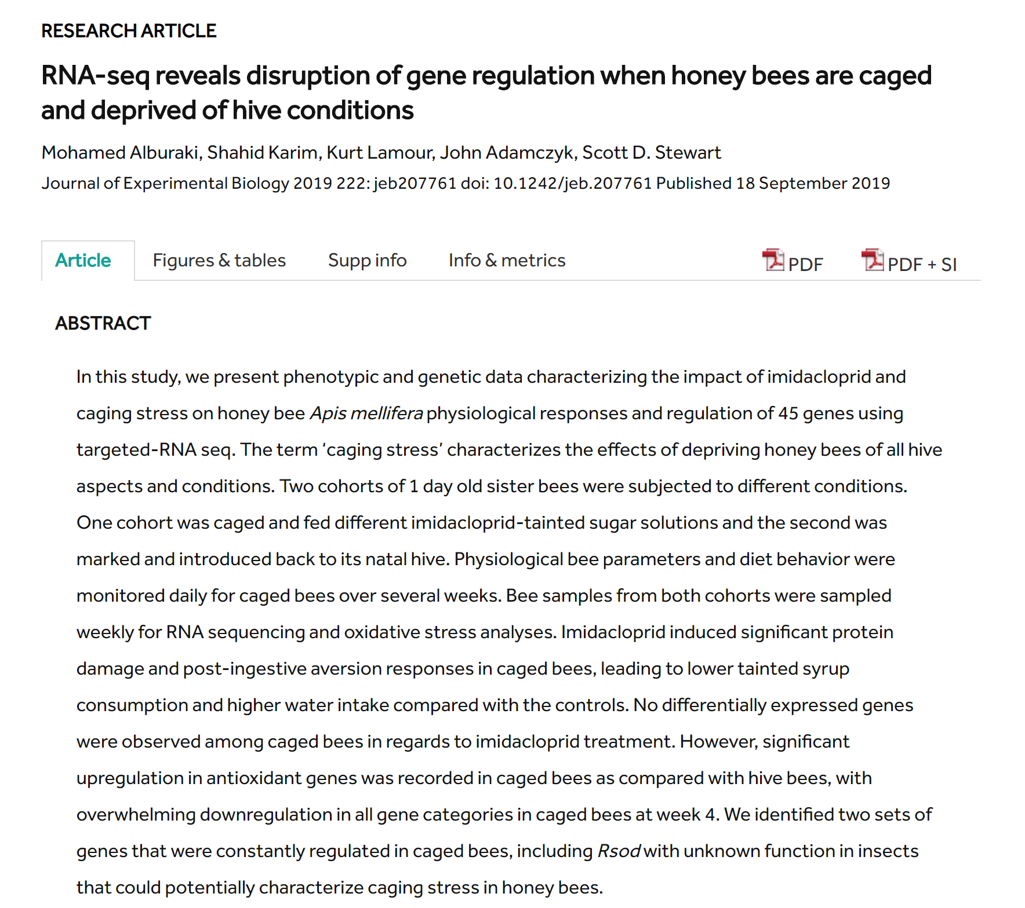
Comparison of gene expression from caged and uncaged honeybees

Slide 7
Hypotheses Testing
  Null and Alternative hypotheses
  Statistical Test
  P-value and interpretation
Notes:
‘when we design a sci expt, we formulate n and alt hypothesis and then collect data to test them we use statistical test and associated p values to interpret the results

Slide 8
Null and Alternative Hypotheses
The null hypothesis (H₀) – No difference between organisms from control and treatment conditions
The alternative hypothesis (H_{a}) – There is a difference between the results obtained from the control and treatment conditions.
Notes:
We formulate our expt question using null hyp which postulates that no diff
The first step in the procedure is to state the hypotheses null and alternative forms. The null hypothesis (abbreviate “H naught”) is a statement of no difference. The alternative hypothesis (“H sub a”) is a statement of difference. Seek evidence against the claim of H₀ as a way of bolstering H_{a.}
The next slide offers an illustrative example on setting up the hypotheses.

Slide 9
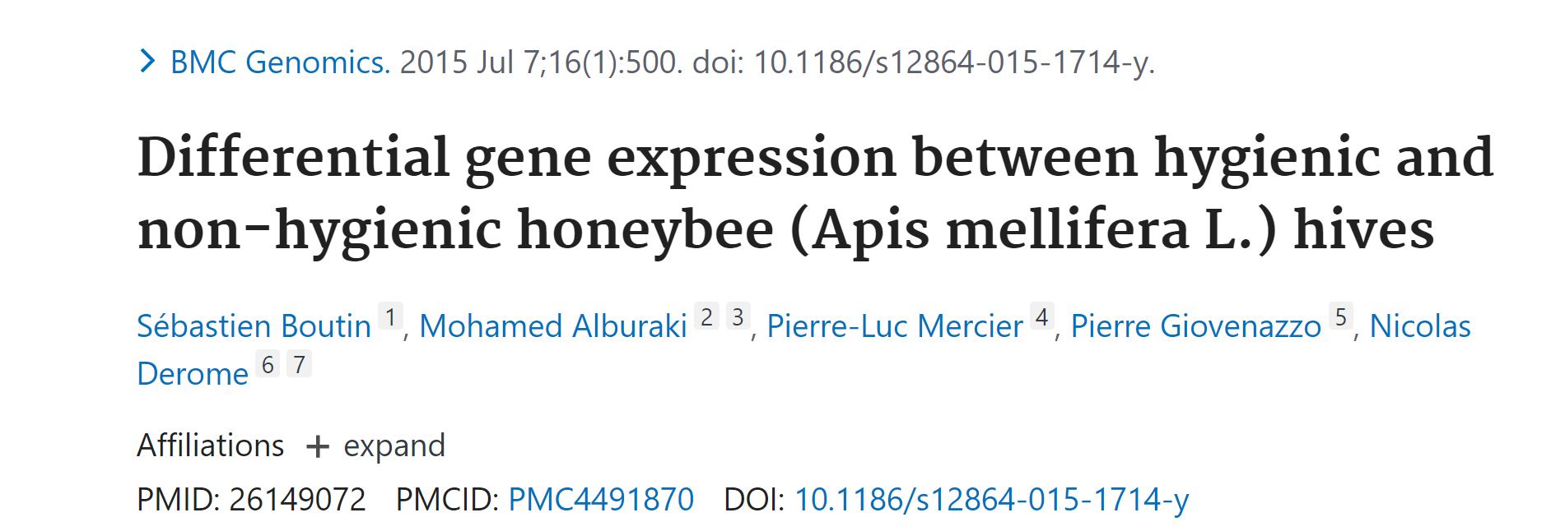
Example of a simple experiment
Two treatment conditions:
  Hygienic
  Non-hygienic
Number of replicates:
3 samples per treatment
Notes:
This is an example of a simple expt done by these authors

Slide 10
What to consider for a test to detect an effect that actually exists
Effect Size: If the size of an effect due to a treatment is large, then it is less likely that it is
due to random events, it will be easier to detect and thus requires fewer replicates
Sample Size: Ability to see differences increases with the number of replicates. More is better!
Generally larger sample size permit the detection of smaller effects
Preliminary data and previous studies can help determine the # of replicates needed
Costs: Cost of sample collection, sample processing, sample analysis, sample storage
play a key role in determining how many samples you can collect and analyze
Variability: If there is high variability in the experimental data, random sampling
error may result in the erroneous detection of differences between
the control and experimental groups
Notes:
There are certain imp things to consider reg num of replicates; one is size of effect – when effect is large it is easier to detect, sample size – how many samples you want to use and you can use
Another thing we need to worry about is variability in the system we need more samples when variability is high
Another factor is cost
All these factors goes into consideration
Collect some preliminary data to determine

Slide 11
Aspects to consider when designing an RNA-Seq experiment
Number and type of replicates
Avoiding confounding factors
Addressing batch effects

Slide 12

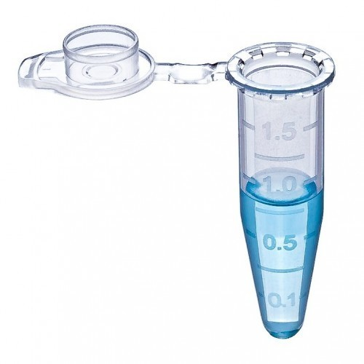
Replication in RNAseq Experiments
Biological Replicate n=3
Different Biological Sample
Same conditions
Measures Biological Variation
Biological replicates are essential for differential expression analysis.
More biological replicates enhance robustness and precision of estimates of biological variation and expression levels, which in turn enable more accurate modeling of data and identification of more differentially expressed genes.
Technical replicates are important because any technique has the potential for error which may originate from a human or machine i.e., pipetting, instrument i.e., all pipettors may not be equally accurate, etc
Technical Replicate n=3
Same Biological Sample
Same conditions
Measures Technical Variation
Notes:
It is imp that we distinguish bn biological and technical replicates

Slide 13
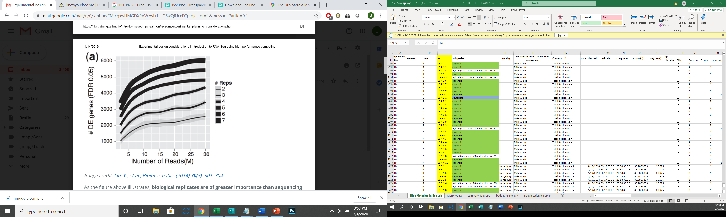
Biological replicates, sequencing depth and differentially expressed genes
Replicates versus Sequencing depth
Biological replicates are of greater importance than sequencing depth (= total number of reads sequenced per sample). In Fig. 1, an increase in the number of replicates tends to return more DE genes than increasing the sequencing depth.
Relationship between sequencing depth and number of replicates on the number of differentially expressed genes identified.

Slide 14
Biological replicates, sequencing depth and differentially expressed genes
Considerations regarding sequencing depth
● General gene-level differential expression;
● Gene-level differential expression with detection of lowly-expressed genes;
● Isoform-level differential expression;
● Other types of RNA analyses (intron retention, small RNA-Seq, ...).

Slide 15
Biological replicates, sequencing depth and differentially expressed genes
Considerations regarding sequencing depth (I)
● General gene-level differential expression:
- ENCODE guidelines suggest 30 million SE reads per sample (stranded);
- 15 million reads per sample is often sufficient, if there are a good number of replicates (>3);
- Spend money on more biological replicates, if possible;
- Generally recommended to have read length >= 50 bp.

Slide 16
Biological replicates, sequencing depth and differentially expressed genes
Considerations regarding sequencing depth (II)
● Gene-level differential expression with detection of lowly-expressed genes:
- Similarly benefits from replicates more than sequencing depth;
- Sequence deeper with at least 30-60 million reads depending on level of expression
(start with 30 million with a good number of replicates);
- Generally recommended to have read length >= 50 bp.

Slide 17
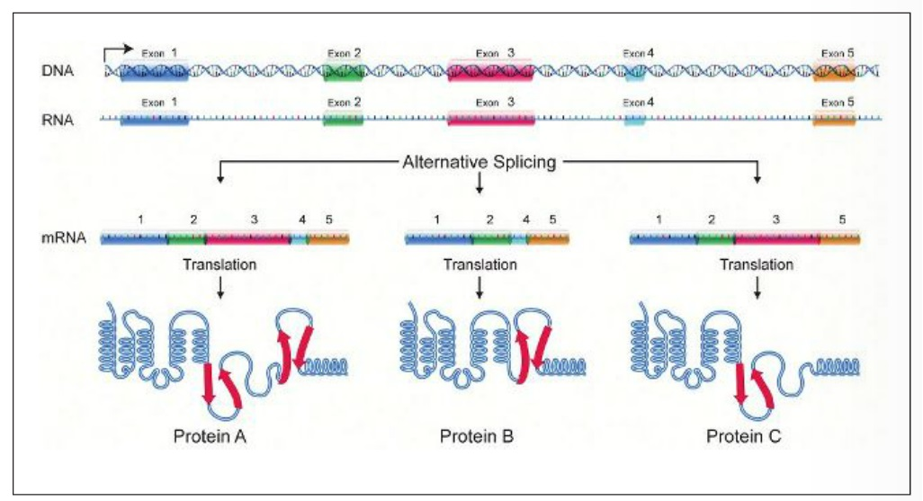
Isoforms
Notes:
Alternative splicing refers to the process by which a gene is spliced into more than one type of mRNA molecule. These distinct mRNA gene isoforms are then translated into individual proteins which can perform unique and sometimes opposing functions in a biological pathway.

Slide 18
Biological replicates, sequencing depth and differentially expressed genes
Considerations regarding sequencing depth (I)
● Isoform-level differential expression:
- Of known isoforms, suggested to have a depth of at least 30 million reads per sample
and paired-end reads;
- Of novel isoforms should have more depth (> 60 million reads per sample);
- Choose biological replicates over paired/deeper sequencing;
- Generally recommended to have read length >= 50 bp, but longer is better as the reads
will be more likely to cross exon junctions;
- Perform careful QC of RNA quality. Be careful to use high quality preparation methods
and restrict analysis to high quality samples.

Slide 19




Design an RNA-seq experiment that avoids confounding and batch effects
A confounded RNA-Seq experiment cannot discriminate the separate effects of two different sources of variation in the data.
Control group
Treatment group
- Ensure animals in each condition are all the same sex, age, and batch or colony, if possible.
- If not possible, then ensure to split the animals equally between conditions.
Control group
Treatment group

Slide 20
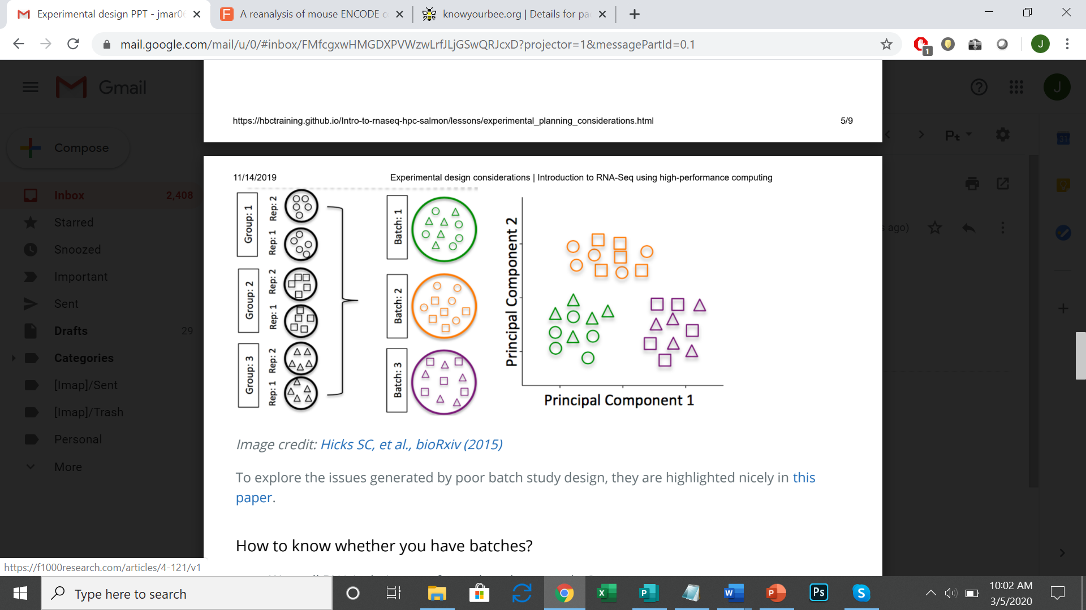
Design an RNA-seq experiment that avoids confounding and batch effects
Batch effects are an issue for RNA-Seq analyses, since it translates into significant differences
in gene expression solely due to the batch effect.
Treatment 1
Treatment 2
Treatment 3
Notes:
Remove Image credit and place ref in Left hand bottom corner

Slide 21
Design an RNA-seq experiment that avoids confounding and batch effects
How to know whether you have batches?
- Were all RNA isolations performed on the same day?
- Were all library preparations performed on the same day?
- Did the same person perform the RNA isolation/library preparation for all samples?
- Did you use the same reagents for all samples?
    - Did you perform the RNA isolation/library preparation in the same location (same equipment)?
If any of the answers are ‘No’, then you have batches

Slide 22
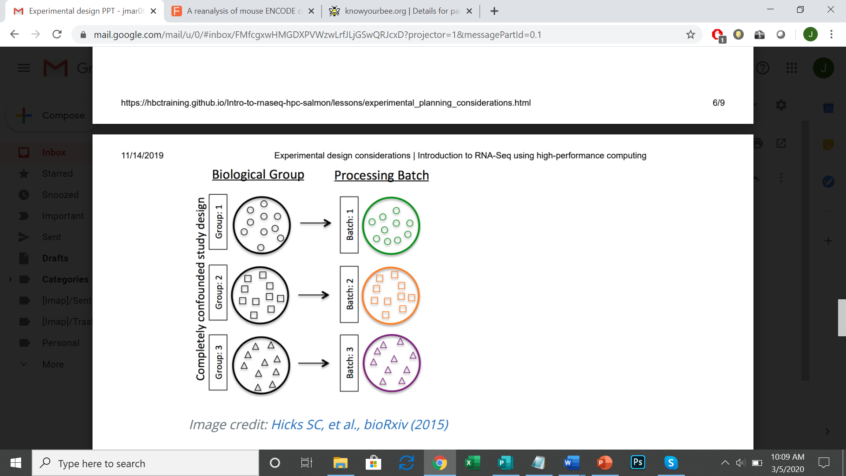
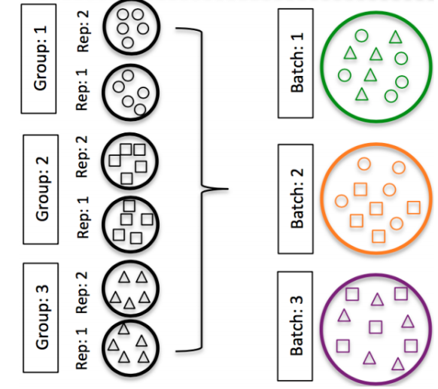
Design an RNA-seq experiment that avoids confounding and batch effects
Best practices regarding batches (I)
When possible, avoid batches in your experimental design.
If unable to avoid batches, do NOT confound your experiment by batch:
DO split replicates of the different sample groups across batches. The more replicates the better (>2).
Treatment 1
Treatment 2
Treatment 3
Notes:
Remove image credit

Slide 23
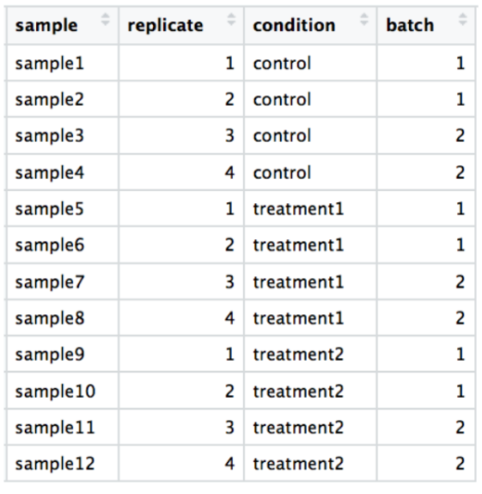
Design an RNA-seq experiment that avoids confounding and batch effects
Best practices regarding batches (II)
DO include batch information in your experimental metadata.
If in your experimental procedure you cannot avoid collecting the data in batches, statistical methods can be used to regress out the variation due to batches.
Below is an article that can serve as an introduction to the topic.
Zhang Y. et al., NAR Genomics and Bioinformatics (2020)

Slide 24
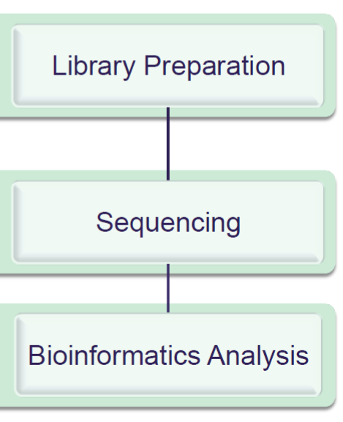
RNA-Seq workflow
Wang, Z., et al. Nature Reviews Genetics (2009)

Slide 25
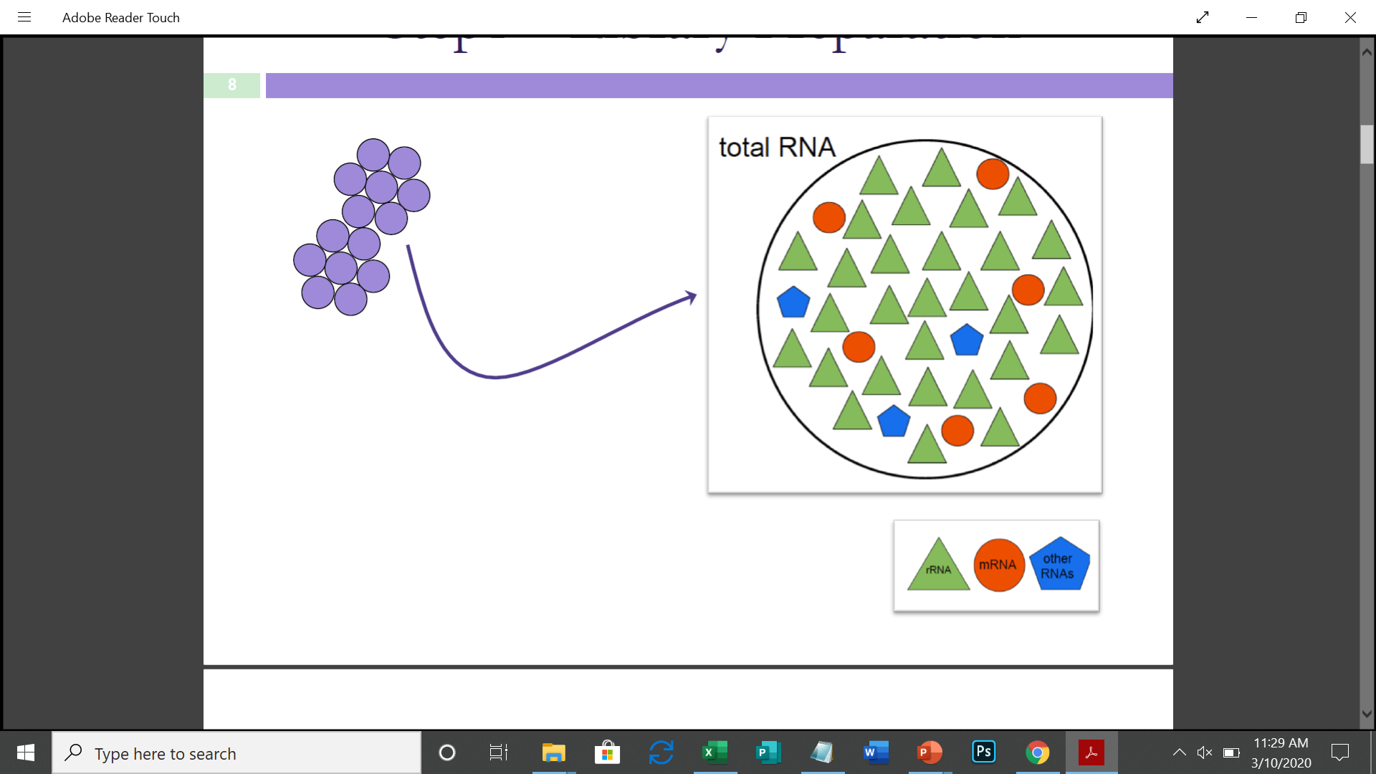
Step 1 - Library preparation
Oligo d(T)25 paramagnetic capture beads
Grassi, L. University of Cambridge Parada, G. Wellcome Trust Sanger Institute
Notes:
Mag beads are used to capture all the RNA in the sample

Slide 26
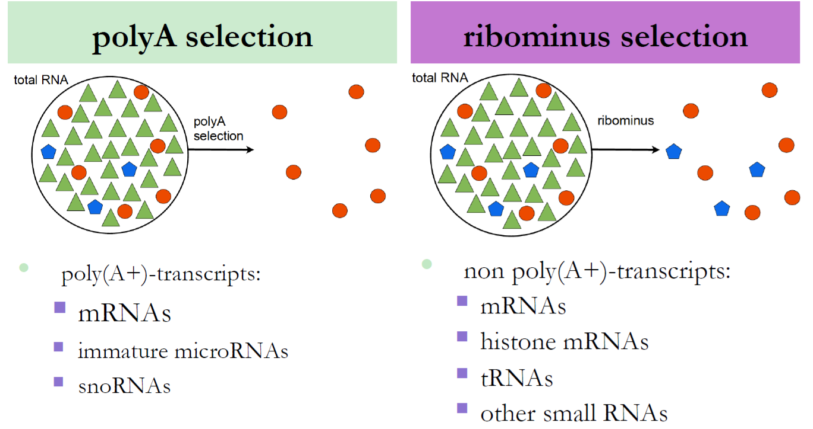
Step 2 - Library preparation
Type 1
Type 2
Grassi, L. University of Cambridge Parada, G. Wellcome Trust Sanger Institute
Notes:
We need to find whether polyA selection extracts mRNAs and other types of RNAs as mentioned in the slide. Also, we need to find out whether ribominus selection extracts the types of RNAs mentioned.

Slide 27
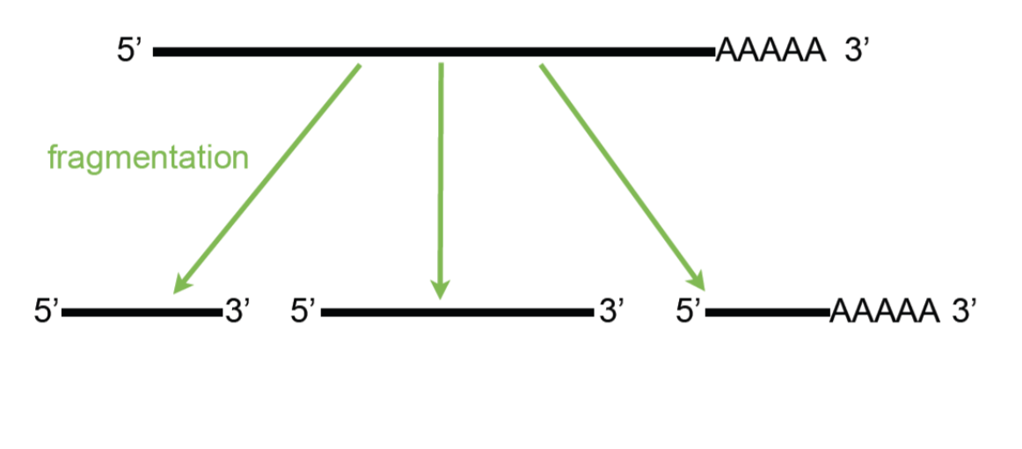
Step 3 - Library preparation
Grassi, L. University of Cambridge Parada, G. Wellcome Trust Sanger Institute

Slide 28
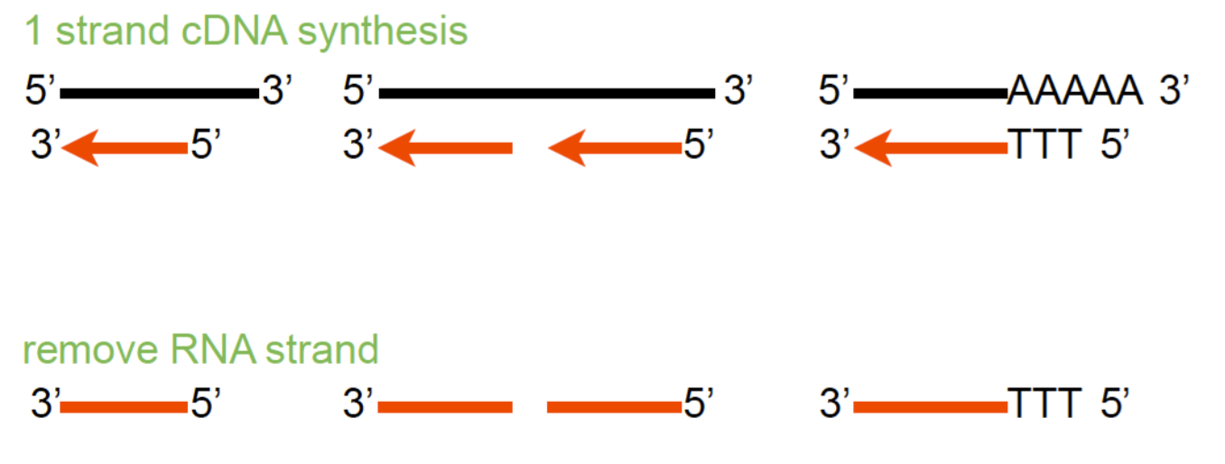
Step 4 - Library preparation
Grassi, L. University of Cambridge Parada, G. Wellcome Trust Sanger Institute

Slide 29
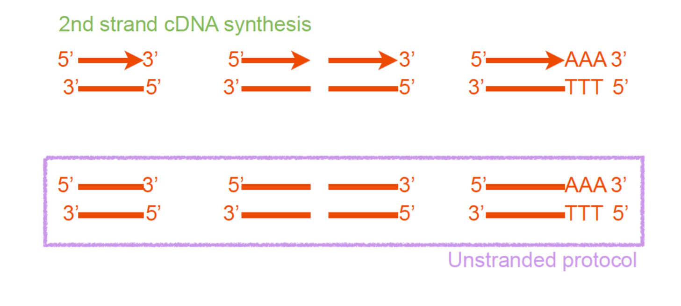
Step 5 - Library preparation
Grassi, L. University of Cambridge Parada, G. Wellcome Trust Sanger Institute

Slide 30
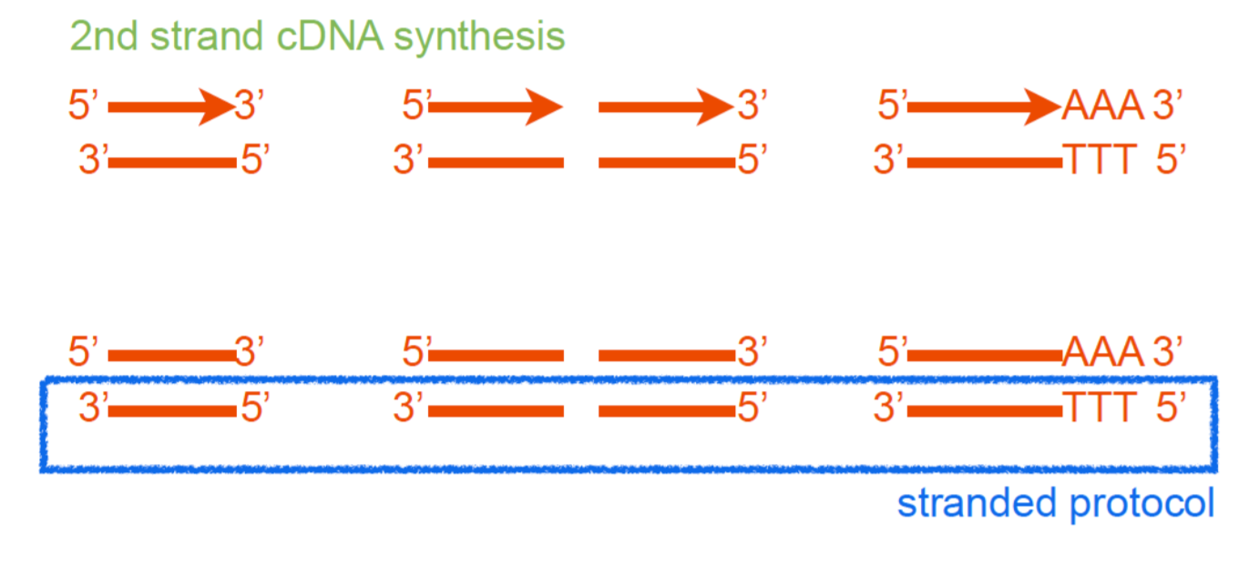
Step 6 - Library preparation
Grassi, L. University of Cambridge Parada, G. Wellcome Trust Sanger Institute

Slide 31
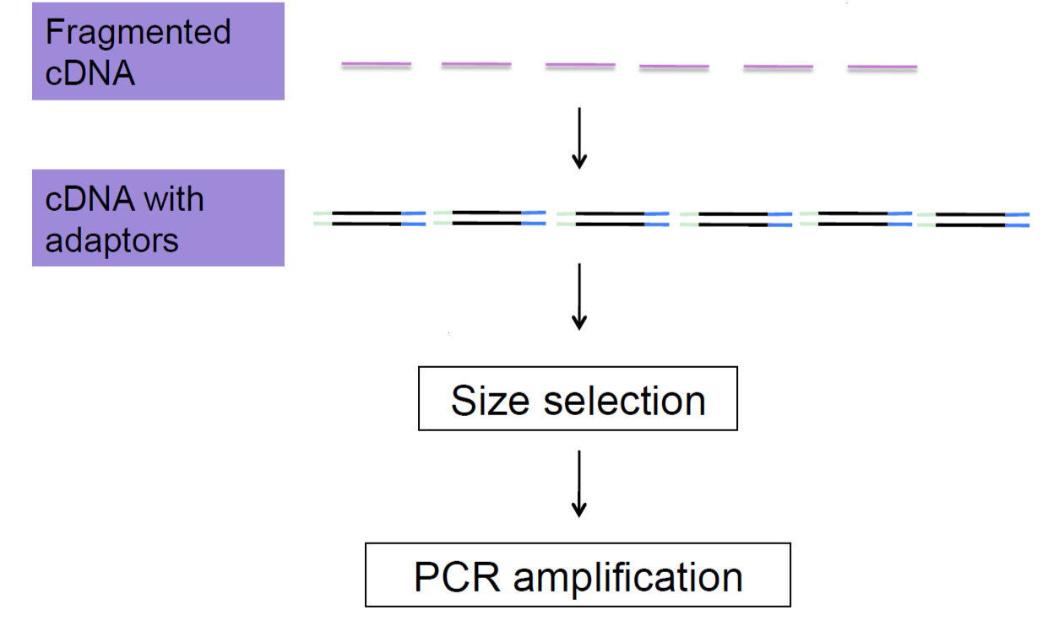
Step 7 - Library preparation
Addition of adapters
Fragments that are optimal for sequencing
Grassi, L. University of Cambridge Parada, G. Wellcome Trust Sanger Institute

Slide 32
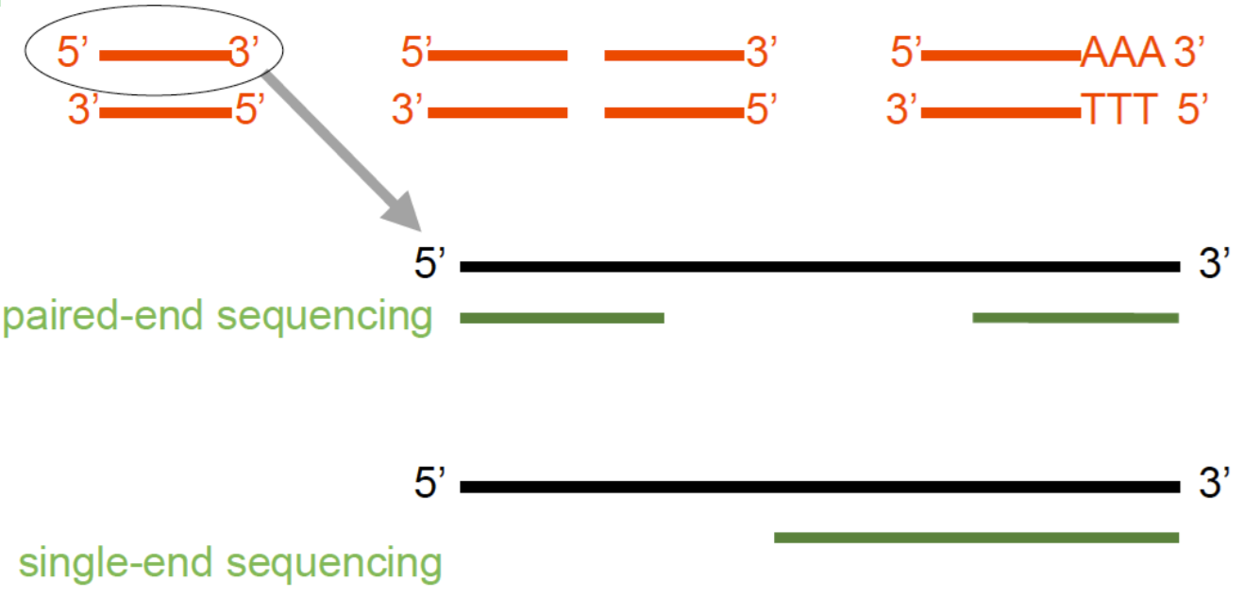
Step 8 - Library preparation
Grassi, L. University of Cambridge Parada, G. Wellcome Trust Sanger Institute

Slide 33
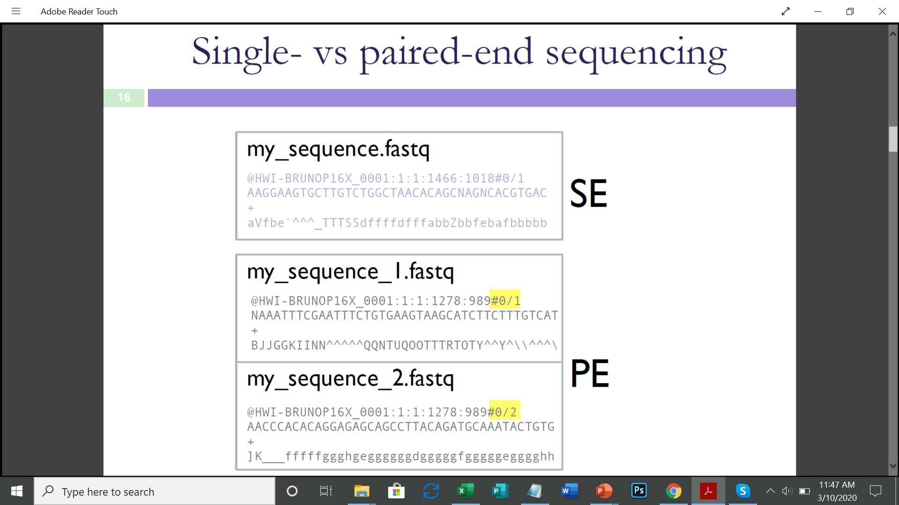
Step 9 – Single-vs paired-end sequencing output fastq file formats
Single end sequencing
Paired end sequencing

Slide 34
Step 10 – Bioinformatics analysis – with reference genome
Reads
Alignment to reference genome
Gene/Transcript abundance
Differentially expressed genes/transcripts

Slide 35
Step 11 – Bioinformatics analysis – with reference genome (low quality)
Reads
Alignment to reference genome
Assemble aligned reads into transcripts
Gene/Transcript abundance
Differentially expressed genes/transcripts

Slide 36
Step 12 – Bioinformatics analysis – without a reference genome - Transcriptome assembly
Reads
Assemble into transcripts
Transcript annotation using public databases
Transcript abundance
Differentially expressed transcripts
Notes:
Kallisto, Salmon, RSEM

Slide 37
Sequencing and annotation formats used for genomic data
FASTA format
FASTQ format
Gene Transfer Format (GTF)
Gene Feature Format v3 (GFF3)
Sequence Alignment/Map format (SAM)
BAM – BGZF compressed SAM format
1
2
3
4
5
6

Slide 38
FASTA format
1
E.g. a read
>unique_sequence_ID
ATTCATTAAAGCAGTTTATTGGCTTAATGTACATCAGTGAAATCATAAATGCTAAAAATTTATGATAAAA
Chromosome
number
NCBI accession
GenBank ID
Genome version
>Group10 gi|323388978|ref|NC_007079.3| Amel_4.5, whole genome shotgun sequence
TAATTTATATATCTATTTTTTTTATTAAAAAATTTATATTTTTGTTAAAATTTTATTTGATTAGAAATAT
TTTTACTATTGTTCATTAATCGTTAATTAAAGATAGCACAGCACATGTAAGAATTCTAGGTCATGCGAAA
TTAAAAATTAAAAATATTCATATTTCTATAATAATTAAATTATTGTTTTAATTTAAGTAAAAAAATTTCT
AAGAAATCAAAAATTTGTTGTAATATTGAAACAAAATTTTGTTGTCTGCTTTTTATAGTAACTAATAAAT

Slide 39
FASTQ format
1
Sequence header
Score header
Quality Score coding

Slide 40
GTF (Gene Transfer Format)
2
  Differences in representation of information make it distinct from GFF;
  1-based coordinates;
  Source of GTF is important – Ensembl GTF is not quite the same as UCSC GTF.
AB000381 Twinscan CDS 380 401 . + 0 gene_id "001"; transcript_id "001.1";
AB000381 Twinscan CDS 501 650 . + 2 gene_id "001"; transcript_id "001.1";
AB000381 Twinscan CDS 700 707 . + 2 gene_id "001"; transcript_id "001.1";
AB000381 Twinscan start_codon 380 382 . + 0 gene_id "001"; transcript_id "001.1";
AB000381 Twinscan stop_codon 708 710 . + 0 gene_id "001"; transcript_id "001.1";
Source
End location
Strand
Attributes (hierarchy)
Chromosome ID
Start location
Reading frame
Gene feature
Score (user defined)
Holmes, J. HPCBio, Univ. of IL

Slide 41
GFF3 (Gene feature format v3)
3
Tab-delimited file to store genomic features, e.g. genomic intervals of genes and gene structure;
Meant to be unified replacement for GFF/GTF (includes specification);
All but UCSC have started using this (UCSC prefers their own internal; formats)
1-based coordinates.
Chr1 amel_OGSv3.1 gene 204921 223005 . + . ID=GB42165
Chr1 amel_OGSv3.1 mRNA 204921 223005 . + . ID=GB42165-RA;Parent=GB42165
Chr1 amel_OGSv3.1 3’UTR 222859 223005 . + . Parent=GB42165-RA
Chr1 amel_OGSv3.1 exon 204921 205070 . + . Parent=GB42165-RA
Chr1 amel_OGSv3.1 exon 222772 223005 . + . Parent=GB42165-RA
Source
End location
Strand
Attributes (hierarchy)
Chromosome ID
Start location
Gene feature
Phase
Score (user defined)
Holmes, J. HPCBio, Univ. of IL

Slide 42
GFF3 vs. GTF formats
4
GFF3 – Gene feature format
GTF – Gene transfer format
Always check which of the two formats is accepted by your application of choice, sometimes they cannot be swapped
Chr1 amel_OGSv3.1 gene 204921 223005 . + . ID=GB42165
Chr1 amel_OGSv3.1 mRNA 204921 223005 . + . ID=GB42165-RA;Parent=GB42165
Chr1 amel_OGSv3.1 3’UTR 222859 223005 . + . Parent=GB42165-RA
Chr1 amel_OGSv3.1 exon 204921 205070 . + . Parent=GB42165-RA
Chr1 amel_OGSv3.1 exon 222772 223005 . + . Parent=GB42165-RA
AB000381 Twinscan CDS 380 401 . + 0 gene_id "001"; transcript_id "001.1";
AB000381 Twinscan CDS 501 650 . + 2 gene_id "001"; transcript_id "001.1";
AB000381 Twinscan CDS 700 707 . + 2 gene_id "001"; transcript_id "001.1";
AB000381 Twinscan start_codon 380 382 . + 0 gene_id "001"; transcript_id "001.1";
AB000381 Twinscan stop_codon 708 710 . + 0 gene_id "001"; transcript_id "001.1";
Holmes, J. HPCBio, Univ. of IL

Slide 43
SAM format
5
SAM – Sequence Alignment/Map format
  SAM file format stores alignment information
Plain text
Specification: http://samtools.sourceforge.net/SAM1.pdf
Contains quality information, meta data, alignment information, sequence etc.
Files can be very large: Many 100’s of GB or more
Normally converted into BAM to save space (and text format is mostly useless for downstream analyses)
@HD [format version]
@SQ SN:chr_1 LN:12345678
@PG [information about program that made this]
HWI-D00758:59:C7U2JANXX:1:1101:1398:2079 0 chr_1 130447256 255 1S9M * 0 0 NAGCTCTTTA #/<<BFBBFF NH:i:1 HI:i:1 AS:i:93 nM:i:2
Holmes, J. HPCBio, Univ. of IL

Slide 44
BAM format
6
BAM – BGZF compressed SAM format
  Compressed/binary version of SAM and is not human readable. Uses a specialized compression algorithm optimized for indexing and record retrieval (bgzip)
  Makes the alignment information easily accessible to downstream applications (large genome file not necessary)
  Unsorted, sorted by sequence name, sorted by genome coordinates
  May be accompanied by an index file (.bai) (only if coordinate sorted)
Files are typically very large: ~ 1/5 of SAM, but still very large
Holmes, J. HPCBio, Univ. of IL

